Slide 1
Team-based Integrated Circuit Design
ECE 482
Alec Wasowicz

Slide 2
Working as a Team

Slide 3
Introduction Slides
Real world IC design is far too complex for a single person
Efficient work relies on two processes
Assigned job roles
Layout Engineer
Design Engineer
Test Engineer
Modular, hierarchy-based design
Independent, functional blocks are created separately and then merged to finish the final design
In this class, we want all students to understand the full process of IC design. Therefore, it is NOT recommended to follow this strategy just yet.

Slide 4
Introduction Slides
There is no “correct” way to set up a team
Every good way shares some habits
Clear communication about design decisions, practices, and naming conventions
Contribution from every group member
This presentation is designed to give a rough overview of how IC design as a team works, not an exact guide

Slide 5
Hierarchy-based Design

Slide 6
Hierarchy
Designs are broken down into functional blocks
Simplify schematic and layout for understanding
Breaks the work into manageable pieces
Allows copies of similar circuits to save time
Each block is independent except for the pre-determined interactions with other blocks
I.e. The logic designer doesn’t care how the clock is generated, just that it will be provided to their functional block
The design of each block is decoupled from how the other functions are realized in circuitry

Slide 7
Hierarchy Example
Simple Microcontroller
Top Cell
Functional Block
Memory
Logic
Clock Generation
External IO
Sub Cell
SRAM
Addressing
Next State
Output
Divider
Buffers
Receiver
Transmitter
Logic Gates
Simple Logic Gates (NAND, NOR, INV, etc.)
Transistors
Device Level (PMOS, NMOS, Diode, Resistor, Capacitor, etc.)
On a 4-person team, each engineer might design 1 functional block.

Slide 8
Version Control

Slide 9
The problems with hierarchy
We just showed how hierarchy breaks down a large design into manageable chunks
However, this has turned 1 large design file into many small files
This introduces some concerning questions:
How do I know I have the correct version of a cell?
Did my teammate make a change to their block?
What if I accidentally delete/break my teammate’s block?

Slide 10
The solution: Version Control
We clear up these questions by being organized
Declare a functional version of the project as the main version in a central repository
Doubles as backup in case of errors
When you want to update a file, edit a local copy of the main version
For clarity, only have 1 person editing a specific file at a time
When finished, insert the file into the reference version
Let your team know the file is done being updated

Slide 11
Version Control in Industry
In Industry, it’s common practice to have a Design Management software that takes care of version control for us
We simply “check-out” a file for editing, locking the file to read-only for everyone else
When done, we “check-in” the file and it becomes the current, working version
Unfortunately, software-based version control isn’t possible in EWS

Slide 12
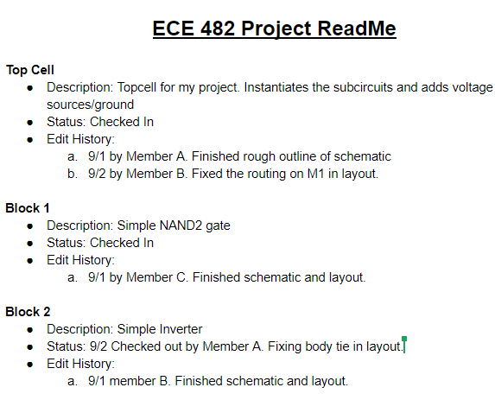
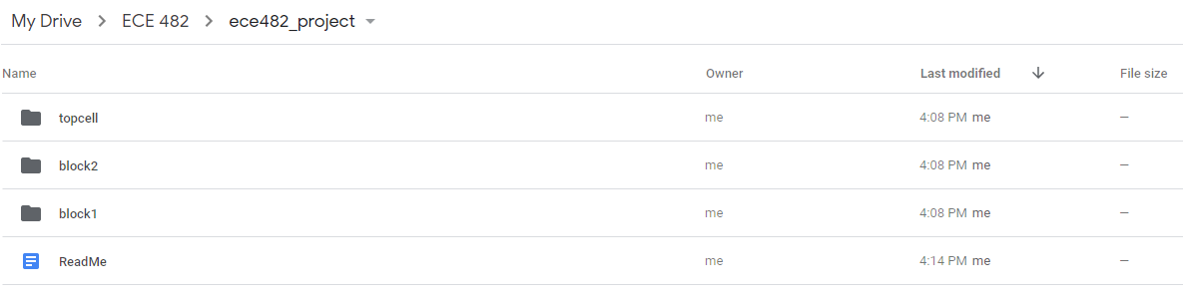
Work-around: Pseudo Design Management
You can practice version control using Google Drive and a word document
Store copies of your project in a shared folder
Manually track changes in the word document

Slide 13
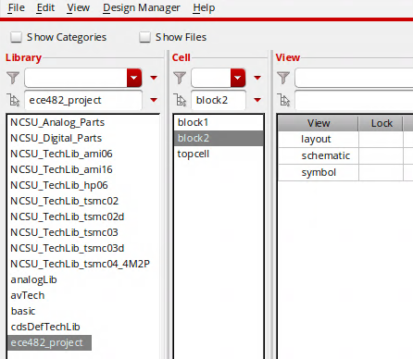
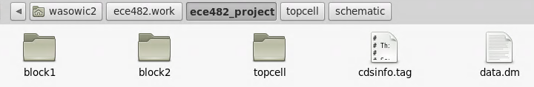
What this looks like in Linux
“ece482_project” is the library I created in Cadence
A directory with the same name is created in ece482.work
Each cell is stored as its own folder within this directory
To update the reference design, I upload my version to Drive
To update my version, I download and replace the folder in my EWS workspace
Do this with Cadence closed

Slide 14
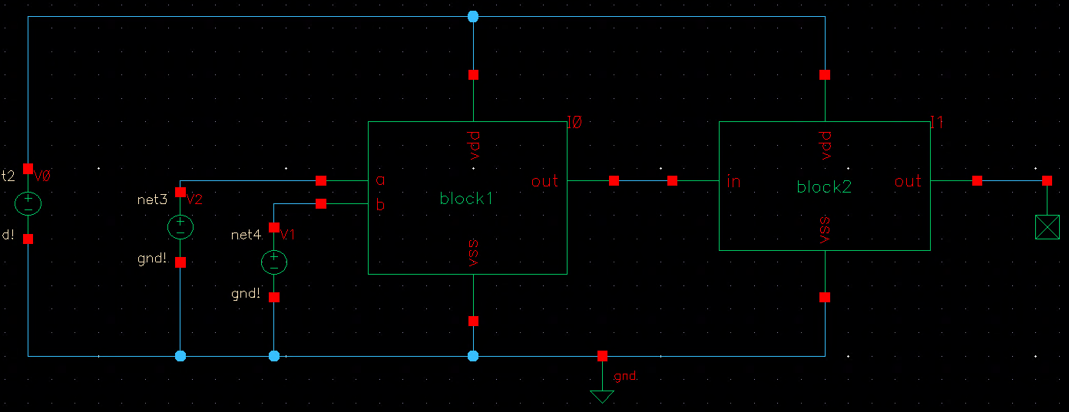
What the design looks like
topcell schematic instantiates symbols of the lower level blocks instead of circuit elements
Look at Cadence documentation if you don’t know how to make/instantiate a symbol
topcell layout uses lower level layouts in a similar way
Schematic for “topcell”

Slide 15
Final Reminders
Don’t update the team’s shared repository until your local version is functional after your edits
Communicate with your team
Be clear on what’s expected from each block, naming conventions, layout conventions
The more in-sync you are, the more productive your team can be
These have been rough guidelines. Many companies implement these systems slightly differently
If your team finds a much more efficient method, feel free to use it
(And share it on Piazza, not every student starts 482 with Cadence experience)

